Slide 1
BATTERIES AND TYPES

Slide 2
υ General aspects on power systems
ϖ Classification of batteries
ω Classical examples of power systems
ξ Special view on lead-acid system
ψ About lithium batteries

Slide 3
BATTERY - cell - power packs - power sources
Is a source of energy, obtained by the conversion of chemical energy from chemical reaction into electrical energy
Thus BATTERIES represent a silent form of energy producing chemical devices, which generate electricity on demand

Slide 4
Hype on Batteries…?
The rapidity with which energy resources and oil fields are consumed at present and in the future will depend on the rapidity with which regions of the world industrialize, the rate of population growth, the ultimate level of human desires to possess material goods and the effort that is made to accelerate production
The growing concern with managing the costs of military, space crafts, portable electronics, implantable medical devices,
communication technology etc.,
The importance of preserving our green environment mainly because of the very high rate of industrialization, modernization and partly due to population explosion etc., has placed an increased emphasis on efficient power sources
SO…. BATTERIES…. Boon….. For energy re-regeneration

Slide 5




CATHODE
ANODE
ELECTROLYTE
SEPARATOR
CONTAINER

Slide 6


CELL CONSTRUCTION
SEPARATOR
ELECTROLYTE
CATHODE
ANODE
CONTAINER

Slide 7
CELL REACTIONS
IN A BATTERY SYSTEM
ANODE REACTION: is an oxidation reaction which releases electrons (Anode is the –ve electrode in EC cell)
CATHODE REACTION: is a reduction reaction which consumes electrons (Cathode is the +ve electrode in EC cell)
ELECTROLYTE is an ion-conducting medium which conducts ions between the electrodes so that the above reactions can take place

Slide 8


WORKING PRINCIPLE
A
_{e}-
V
_
+

Slide 9
CLASSIFICATION OF BATTERIES
1.PRIMARY BATTERY
- for single use only
2. SECONDARY BATTERY
- for repeated use

Slide 10
1. PRIMARY BATTERY
- Non-rechargeable (cell reactions are irreversible)
- Self-discharges whether used or not
LECLANCHE CELLS (Zn/C) - Popular low-cost system
Applications: Torch light, portable radios, toys, novelties, etc.
Mg/MnO₂ CELLS - High capacity system
Applications: Military communication equipment, voting machines, etc.

Slide 11
RESERVE BATTERY
- one of the cell components, usually the electrolyte, is kept isolated from the rest and is added at the time of need
Mg/Cu₂Cl₂, Mg/AgCl (sea water activated battery) Applications: Torpedoes, Sea beacons (Mainly in Meteorology and Defence fields)
Li/FeS₂ (Thermally activated battery) Applications: In Missiles

Slide 12
2. SECONDARY BATTERY
- Rechargeable (cell reactions are reversible)
Lead-Acid Battery (Pb/H+) Nickel-Cadmium Battery (Ni-Cd) Nickel-Iron Battery (Ni-Fe)
Nickel-Metal hydride Battery (Ni-MH) Lithium battery (Li-LiM_{x}O_{y})
Lithium-Ion battery (C-LiM_{x}O_{y})
Lithium-Ion Polymer Battery (C-LiM_{x}O_{y})

Slide 13
LEAD-ACID BATTERY
ANODE CATHODE
ELECTROLYTE CELL VOLTAGE
APPLICATIONS:
: Pb
: PbO₂
: H₂SO₄
: 2.0 V
AUTOMOTIVE STARTING--LIGHTING--IGNITION (SLI), ELECTRIC VEHICLES, EMERGENCY POWER UTILITIES, PORTABLE TOOLS, INDUSTRIAL TRUCKS, ETC.

Slide 14
LITHIUM SECONDARY BATTERY
ANODE CATHODE
ELECTROLYTE CELL VOLTAGE
: Li METAL
: LiCoO₂
: LiPF₆ in EC:PC
: 4 V
APPLICATIONS:
ELECTRIC VEHICLES, PORTABLE ELECTRONIC DEVICES, ETC.

Slide 15
LITHIUM-ION BATTERY
ANODE CATHODE
ELECTROLYTE CELL VOLTAGE
: CARBON
: LiCoO₂
: LiPF₆ in EC:PC
: 4 V
APPLICATIONS:
ELECTRIC VEHICLES, CELL PHONES, CAMCORDERS, LAP-TOP AND PALM- TOP COMPUTERS, PORTABLE ELECTRONIC DEVICES, ETC.

Slide 16
LITHIUM-POLYMER BATTERY
ANODE CATHODE
: Li
: LiCoO₂
ELECTROLYTE : SOLID POLYMER FILMS CELL VOLTAGE : 4 V
APPLICATIONS:
ELECTRIC VEHICLES, CREDIT CARDS, SLIM ELECTRONIC DEVICES, ETC.

Slide 17
LITHIUM-ION POLYMER BATTERY
ANODE CATHODE
: CARBON
: LiCoO₂
ELECTROLYTE : SOLID POLYMER FILMS CELL VOLTAGE : 4 V
APPLICATIONS:
ELECTRIC VEHICLES, PORTABLE ELECTRONIC DEVICES, ETC.

Slide 18
LEAD-ACID BATTERY
ANODE CATHODE
ELECTROLYTE CELL VOLTAGE
: Pb
: PbO₂
: H₂SO₄
: 2.0 V

Slide 19
At positive plate:
REACTIONS DURING CHARGING
PbSO₄ + 2H₂O ◊PbO₂ + 4H⁺ + SO₄²⁻ + 2e⁻
2H₂O ◊O₂ + 4H⁺ + 4e⁻
At negative plate:
PbSO₄ + 2e⁻ ◊ Pb + SO₄²⁻ 2H⁺ + 2e⁻ ◊ H₂
OVERALL CELL REACTION
Charge
2PbSO₄ + 2H₂O Pb + 2H₂SO₄ + PbO₂
Discharge

Slide 20
The success of Pb/H⁺ battery is due to:
Raw material is cheap and also can be recovered from scrap (spent batteries)
Supply of high power over a wide range of temp. Very high reversibility
Availability of mass production techniques Availability of multifarious battery configurations Maintenance free

Slide 21
BATTERY TESTING METHODS FOR Pb/H⁺ BATTERIES
∧ Air Pressure test (A check for cell sealing)
∧ Capacity test
∧ High rate discharge test
∧ Charge retention test
∧ Over charge resistance test (determining the life or
health of the grid materials)
∧ Life test (determining life or health of the +ve or
-ve plate active material)
∧ Vibration test

Slide 22
CHARGING PROCEDURES
Constant current or galvanostatic charging (single step, two step, multistep galvanostatic charging)
Constant voltage charging Controlled current-voltage charging Modified constant-voltage charging Tapered charging
Boost charging Trickle charging Float charging Equalizing charging Pulse charging
Gas controlled charging

Slide 23
FACTORS AFFECTING BATTERY PERFORMANCE AND LIFE
***
The cathode/anode composition, its design, nature and characteristics of the oxide, composition of paste, curing, formation and initial charging methods, concentration of the acid, the separators, rate of discharge and temperature of operation
Particle size, surface area, water and acid absorption rate, plate porosity, crystallography of the oxide etc.,

Slide 24
Failure of Pb/H⁺ batteries due to:
ξ Long standing in discharged condition
ξ Too high acid concentration
ξ Prolonged under-charging
ξ Increased self-discharge
ξ Continuous operation between 40 & 50^{C}

Slide 25
PROBABLE TYPES OF DEFECTS IN Pb/H⁺ BATTERIES
Positive plate corrosion Shedding of active materials Short circuting
Sulfation Lagging of cells
Failure of separator
Growth and buckling of plates Explosion

Slide 26
MAINTENACE AND HEALTH MONITORING PROCEDURES FOR Pb/H⁺ BATTERIES
Wiping off the dirt (can lead to self discharge)
Checking the containers and sealing components for crack or seepage
Checking the cables for ensuring good contact with the terminals
Checking and cleaning of the vent holes in the plugs Checking the electrolyte level
Checking the temperature of theelectrolyte Measurement of specific gravity of the electrolyte, cell
voltages, plate potentials by using cadmium electrode and
temperature of the electrolyte particularly at the end of charging and discharging

Slide 27



LITHIUM BATTERY – SALIENT FEATURES
o High working voltage (>3.8V)
o High inherent capacity (>150mAh/g)
o High energy density (>100Wh/Kg)
o Wide electrochemical window (2.5V - ~5V)
o Wide operating temperature (-40 - +80º)
o Light weight (variable with configuration)
o Long shelf-life (~8 years)

Slide 28



CATHODE MATERIALS FOR RECHARGEABLE LITHIUM/LITHIUM-ION BATTERIES
***
3-volt (e.g. LiMnO₂)
4-volt (e.g. LiCoO₂, LiNiO₂, LiMn₂O₄) 5-volt (e.g. LiNiVO₄)
1 Li-ion battery = 3 Ni-Cd / Ni-MH

Slide 29
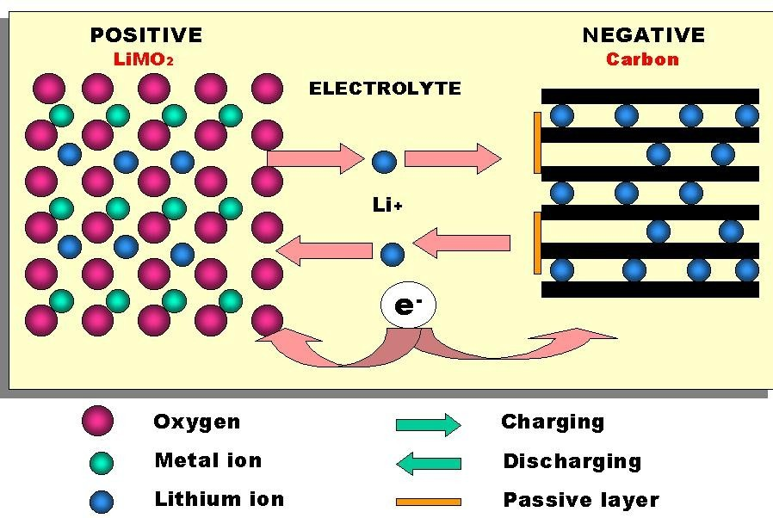
INTERCALATION

Slide 30
SOLID POLYMER ELECTROLYTES FOR Li-ION CELLS
*** HOMOPOLYMERS e.g., PVdF
BLEND POLYMERS e.g., PVC-PVdF COPOLYMERS e.g., PVdF-HFP (KYNAR)

Slide 31
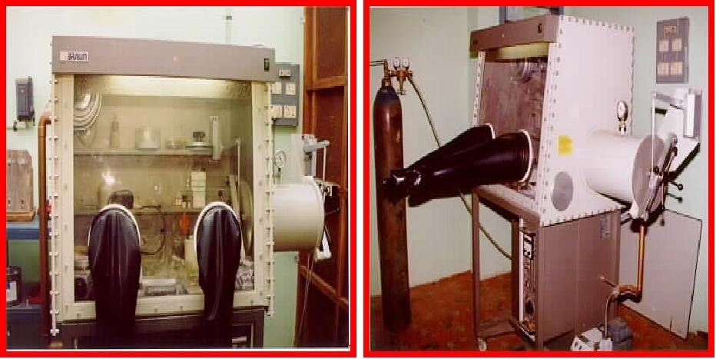
GLOVE BOX
MOISTURE and OXYGEN LEVEL < 20ppm

Slide 32
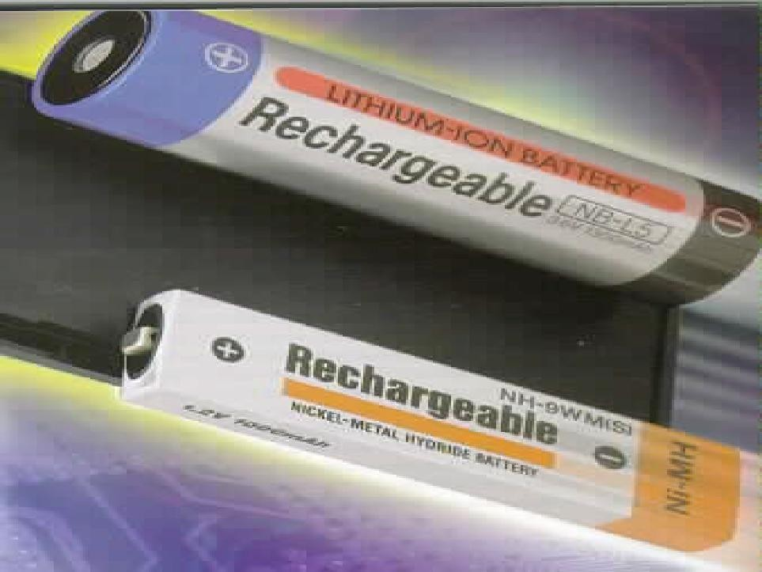

Slide 33



NEED FOR BATTERY OPERATED VEHICLES
(Electric Vehicles - EV)
λ
For conserving natural fuel sources
λ
Decreased air & noise pollution
Battery driven vehicles provide efficient transportation in the near future

Slide 34
CRITERIA OF BATTERY SYSTEMS FOR EV APPLICATIONS
High energy density High power density Good cycle life
Wide temp. range of operation (-30 to +70ºC) Quick recharge
Totally unassisted and maintenance free nature Tolerance to abuse
Non-toxicity of battery materials Safety & reliability, non-polluting

Slide 35



EV PARAMETERS DECIDING THE BATTERY SPECIFICATIONS AND POWER REQUIREMENTS
ϕ Vehicle range
κ Vehicle acceleration
λ Gross vehicle weight
μ Tyre rolling resistance
ν Electric motor efficiency
ο Hill climbing capacity

Slide 36
RECENT TRIALS WITH Ni-MH BATTERY
UNDER APPROPRIATE DRIVING CONDITIONS
Sp. Energy = 70-80Wh/Kg
Range = 200miles peak speed = 90miles/h

Slide 37
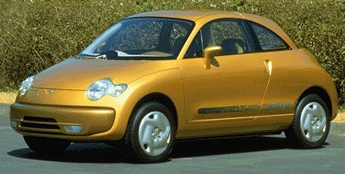
ELECTRIC VEHICLE
NISSAN ALTRA ELECTRIC CAR
POWERED BY SONY LITHIUM- ION BATTERY 120 MILES/CHARGE; SPEED: 60miles/ h

Slide 38



MAKERS OF POWER SYSTEMS – ALL TYPES SANYO
TOSHIBA
MATSUSHITA HITACHI-MAXEL EVEREADY
JAPAN
SONY, PANASONIC, GEC, OVONIC — USA
EAGLE-PICHER, VARTA - GERMANY SAFT – FRANCE, CHINA, KOREA, USA

Slide 39
THANK YOU ALL

